Slide 1
Gradient Descent
Prakash P

Slide 2
Background
Agile is a pretty well-known term in the software development process. The basic idea behind it is simple:
build something quickly ➡️ get it out there ➡️ get some feedback ➡️ make changes depending upon the feedback ➡️ repeat the process.
The goal is to get the product near the user and let the user guide you with the feedback to obtain the best possible product with the least error.
Also, the steps taken for improvement need to be small and should constantly involve the user.
In a way, an Agile software development process involves rapid iterations.
The idea of — start with a solution as soon as possible, measure and iterate as frequently as possible, is basically Gradient descent under the hood

Slide 3
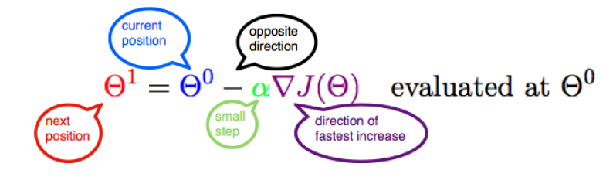
Objective
Gradient descent algorithm is an iterative process that takes us to the minimum of a function.
The formula below sums up the entire Gradient Descent algorithm in a single line

Slide 4
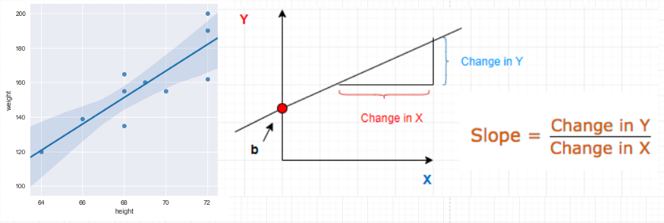
A Machine Learning Model
Consider a bunch of data points in a 2 D space. Assume that the data is related to the height and weight of a group of students.
Trying to predict some kind of relationship between these quantities so that we could predict the weight of some new students afterwards.

Slide 5
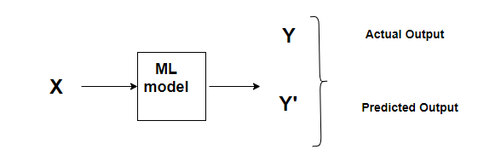

Predictions
Given a known set of inputs and their corresponding outputs, A machine learning model tries to make some predictions for a new set of inputs
The Error would be the difference between the two predictions.
This relates to the idea of a Cost function or Loss function.

Slide 6
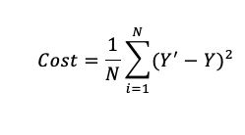
Cost Function
A Cost Function/Loss Function evaluates the performance of our Machine Learning Algorithm.
The Loss function computes the error for a single training example while the Cost function is the average of the loss functions for all the training examples.
A Cost function basically tells us ‘ how good’ our model is at making predictions for a given value of m and b.
Let’s say, there are a total of ’N’ points in the dataset and for all those ’N’ data points we want to minimize the error. So the Cost function would be the total squared error

Slide 7
Minimizing the Cost Function
The goal of any Machine Learning Algorithm is to minimize the Cost Function.
Lower error between the actual and the predicted values signifies that the algorithm has done a good job in learning.
Since we want the lowest error value, we want those‘ m’ and ‘b’ values which give the smallest possible error

Slide 8
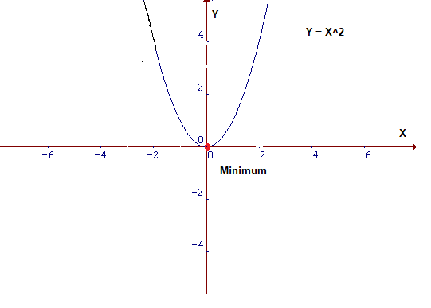
How do we actually minimize any function?
Cost function is of the form Y = X²
In a Cartesian coordinate system, this is an equation for a parabola and can be graphically represented as
To minimise the function above, need to find that value of X that produces the lowest value of Y which is the red dot
It is quite easy to locate the minima here since it is a 2D graph but this may not always be the case especially in case of higher dimensions.
For those cases, need to devise an algorithm to locate the minima, and that algorithm is called Gradient Descent

Slide 9
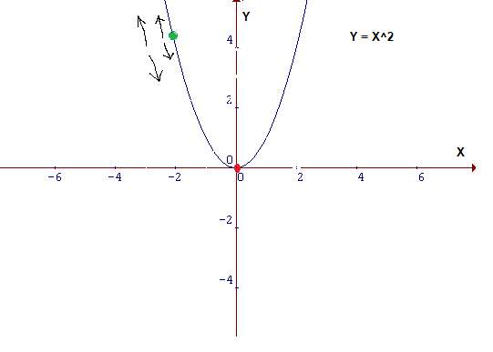
Gradient Descent
Gradient descent is one of the most popular algorithms to perform optimization and by far the most common way to optimize neural networks.
It is an iterative optimisation algorithm used to find the minimum value for a function.
Intuition:
Consider that you are walking along the graph below, and you are currently at the ‘green’ dot.
Your aim is to reach the minimum i.e the ‘red’ dot, but from your position, you are unable to view it.
Possible actions would be:
You might go upward or downward
If you decide on which way to go, you might take a bigger step or a little step to reach your destination.
Gradient Descent Algorithm helps us to make these decisions efficiently and effectively with the use of derivatives

Slide 10
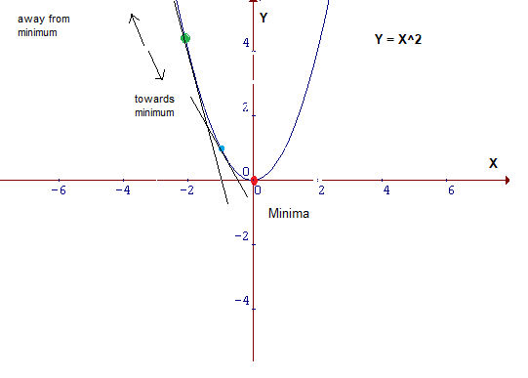
The Minimum Value
A derivative is a term that comes from calculus and is calculated as the slope of the graph at a particular point
The slope at the blue point is less steep than that at the green point which means it will take much smaller steps to reach the minimum from the blue point than from the green point.

Slide 11
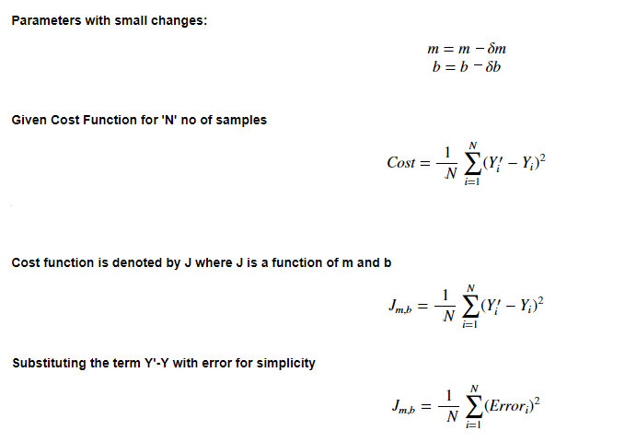
Mathematical Interpretation of Cost Function
In the equation, y = mX+b, ‘m’ and ‘b’ are its parameters. During the training process, there will be a small change in their values.
Let that small change be denoted by δ.
The value of parameters will be updated as m=m-δm and b=b-δb respectively
Our aim here is to find those values of m and b in y = mx+b , for which the error is minimum i.e values which minimize the cost function.

Slide 12
The Learning rate
This size of steps taken to reach the minimum or bottom is called Learning Rate.
We can cover more area with larger steps/higher learning rate but are at the risk of overshooting the minima
On the other hand, small steps/smaller learning rates will consume a lot of time to reach the lowest point

Slide 13
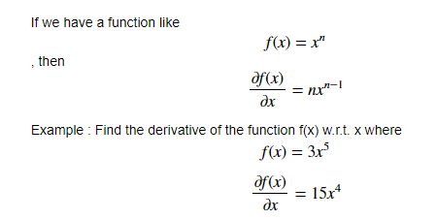

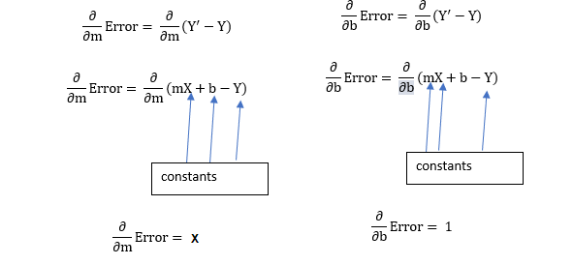

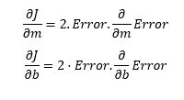
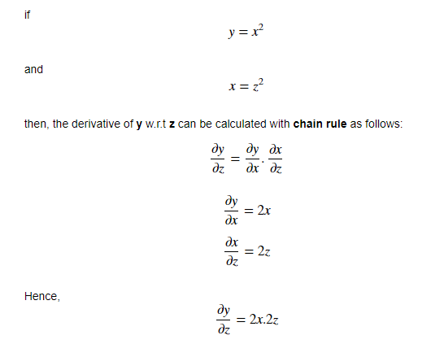

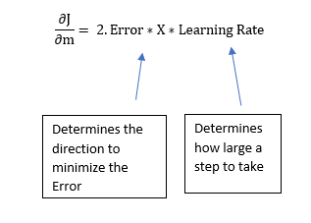
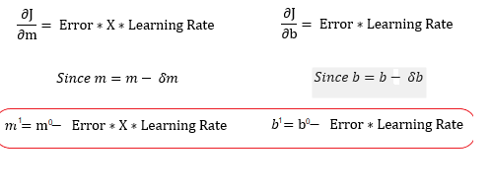
Calculating Gradient Descent
m¹,b¹ = next position parameters; m⁰,b⁰ = current position parameters
This 2 in this equation isn’t that significant since it just says that we have a learning rate twice as big or half as big

Slide 14
Conclusion
Hence, to solve for the gradient,
iterate through our data points using our new m and b values and compute the partial derivatives.
This new gradient tells us the slope of our cost function at our current position and the direction we should move to update our parameters.
The size of our update is controlled by the learning rate.

Slide 15
References
https://machinelearningmastery.com/gradient-descent-for-machine-learning/
https://towardsdatascience.com/understanding-the-mathematics-behind-gradient-descent-dde5dc9be06e

